Slide 1
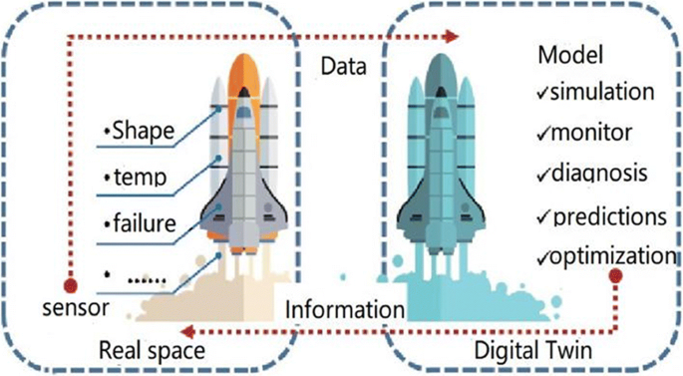
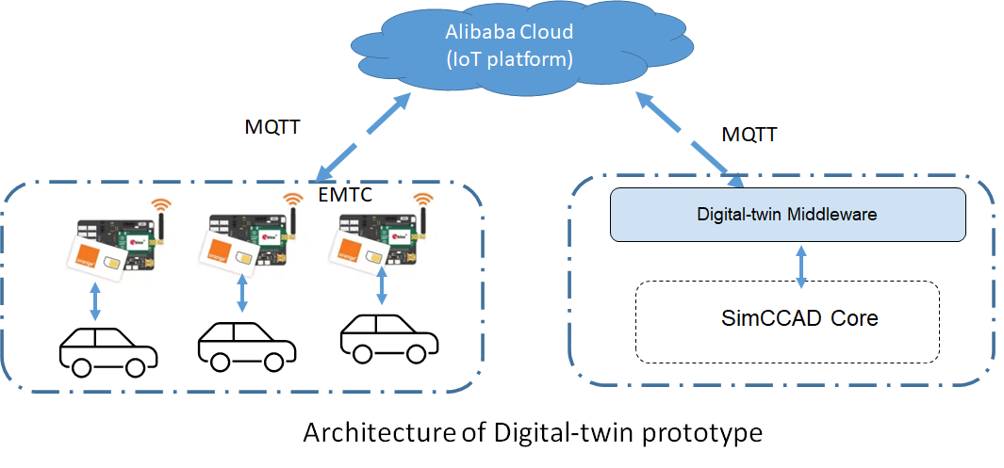
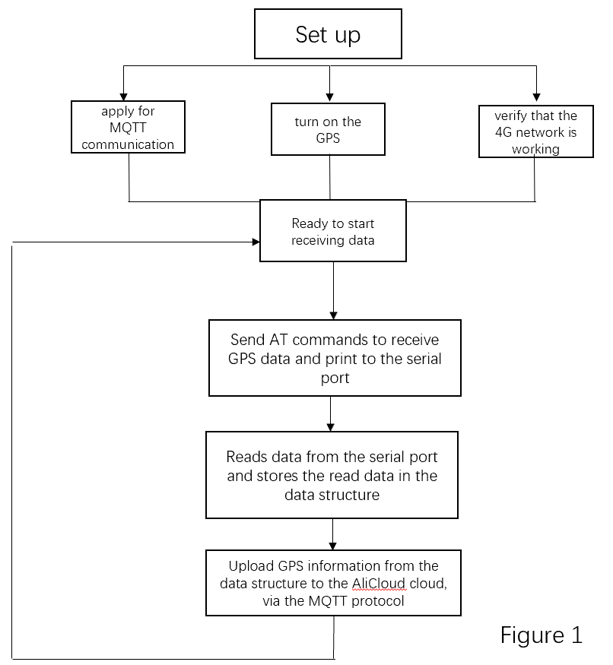
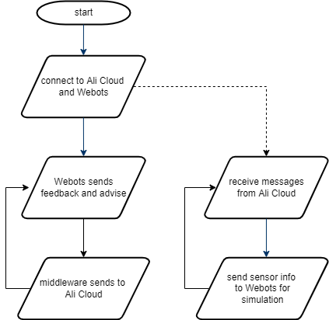
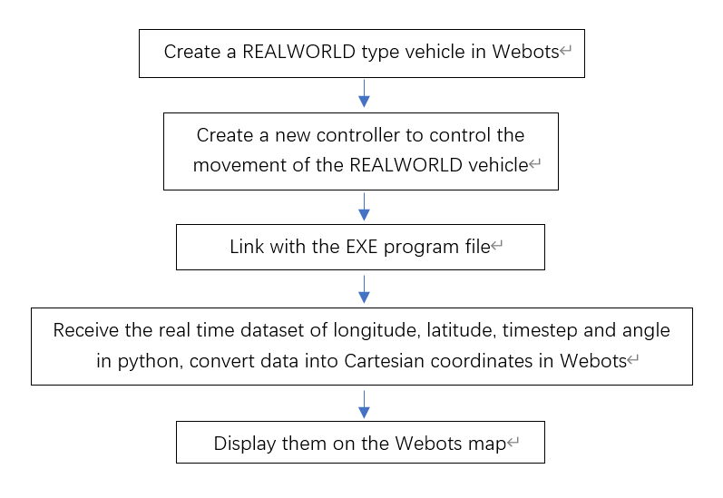
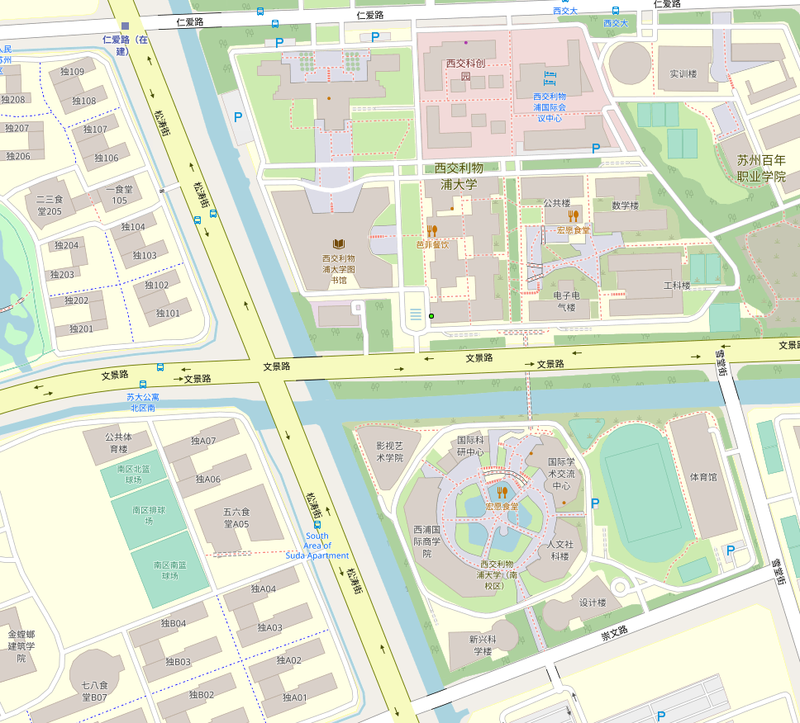
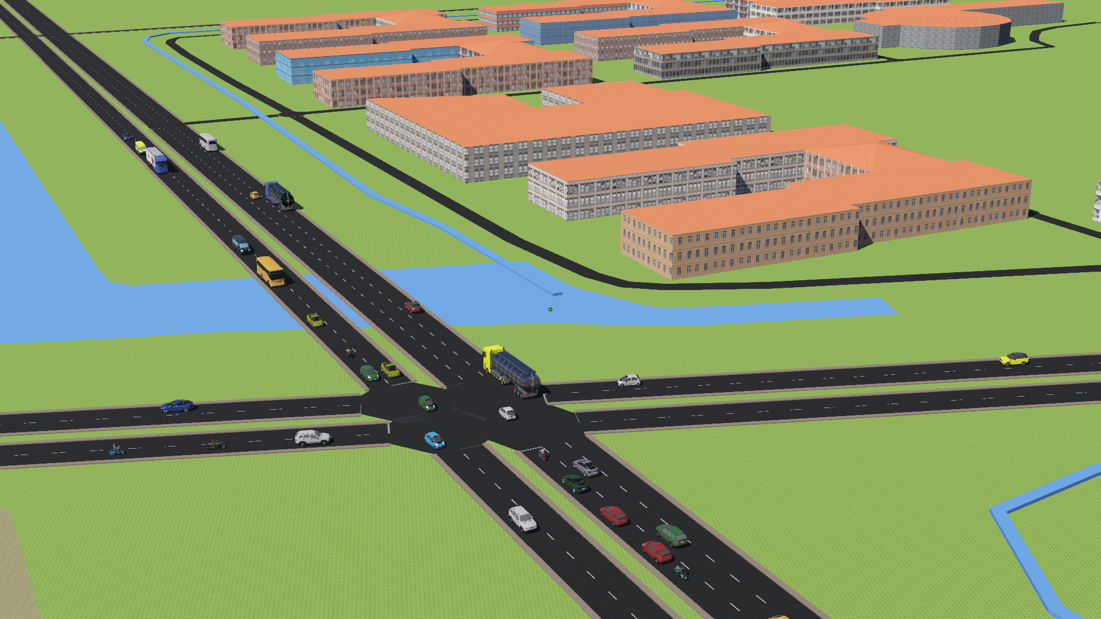
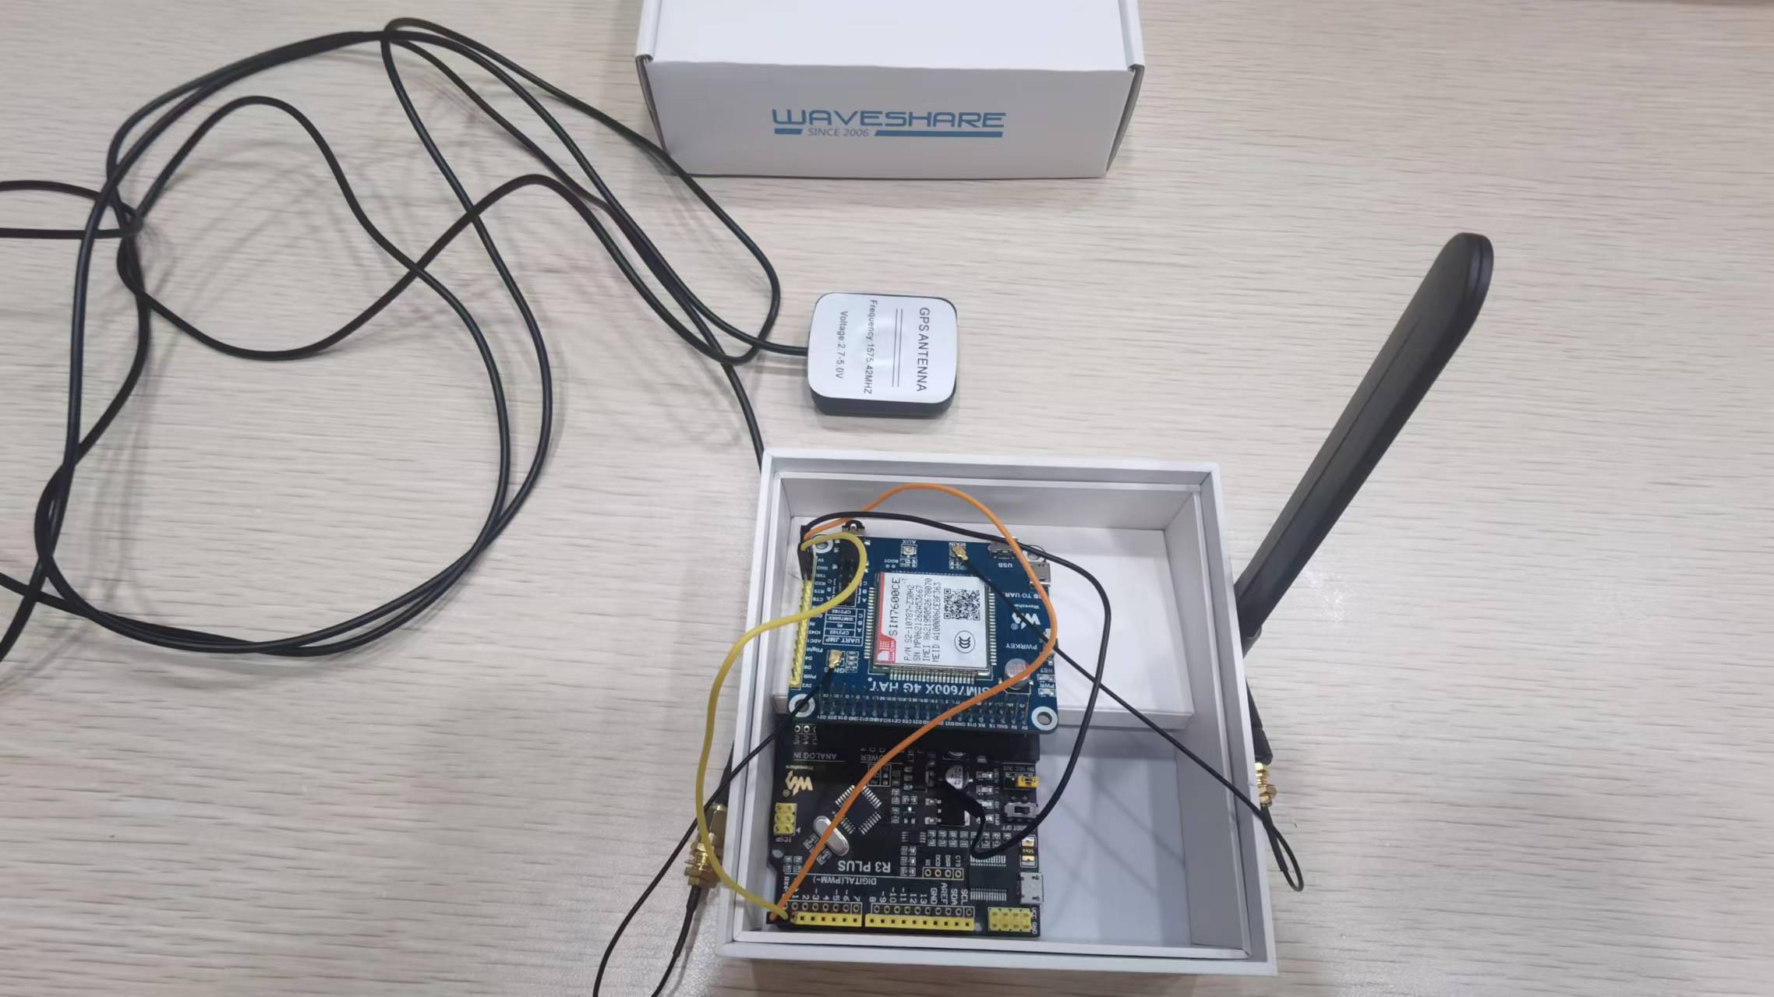
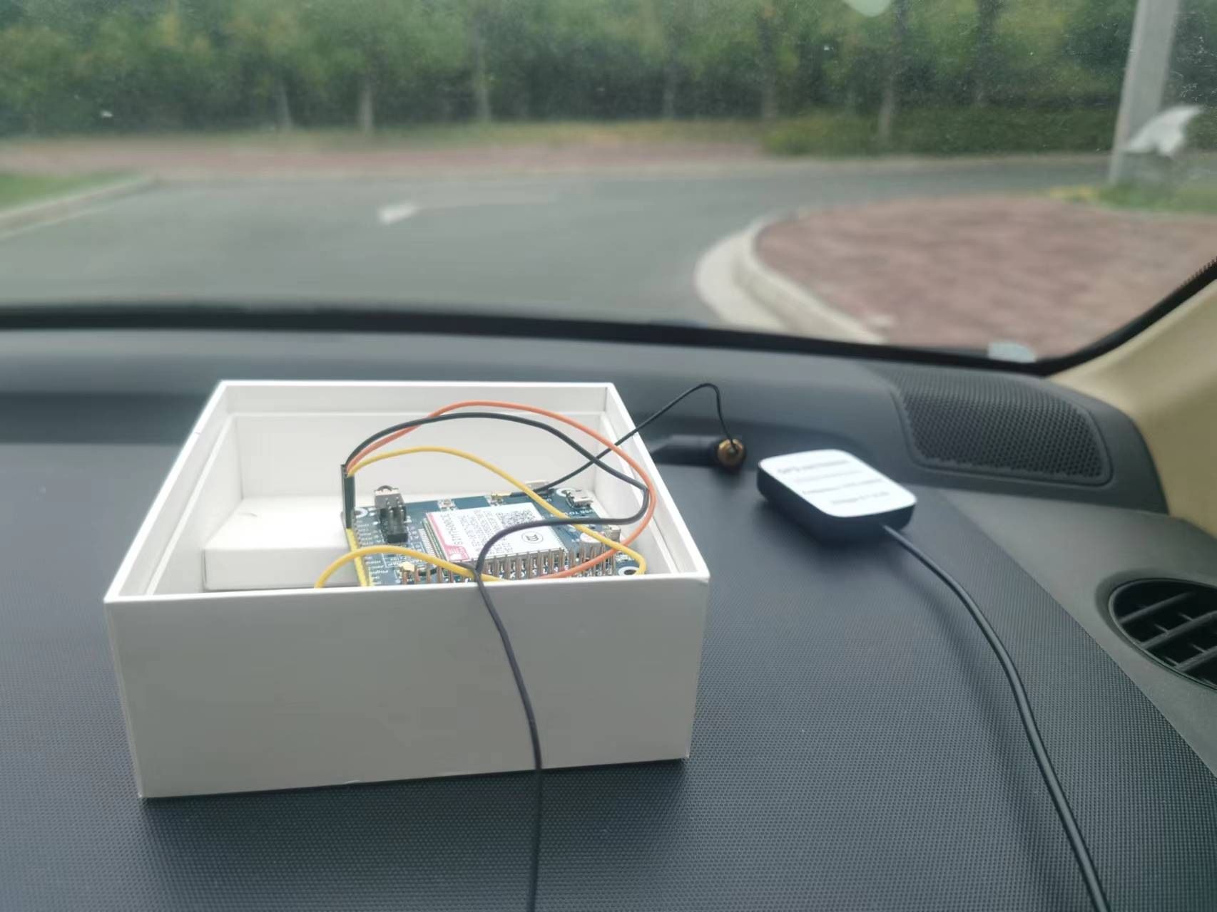
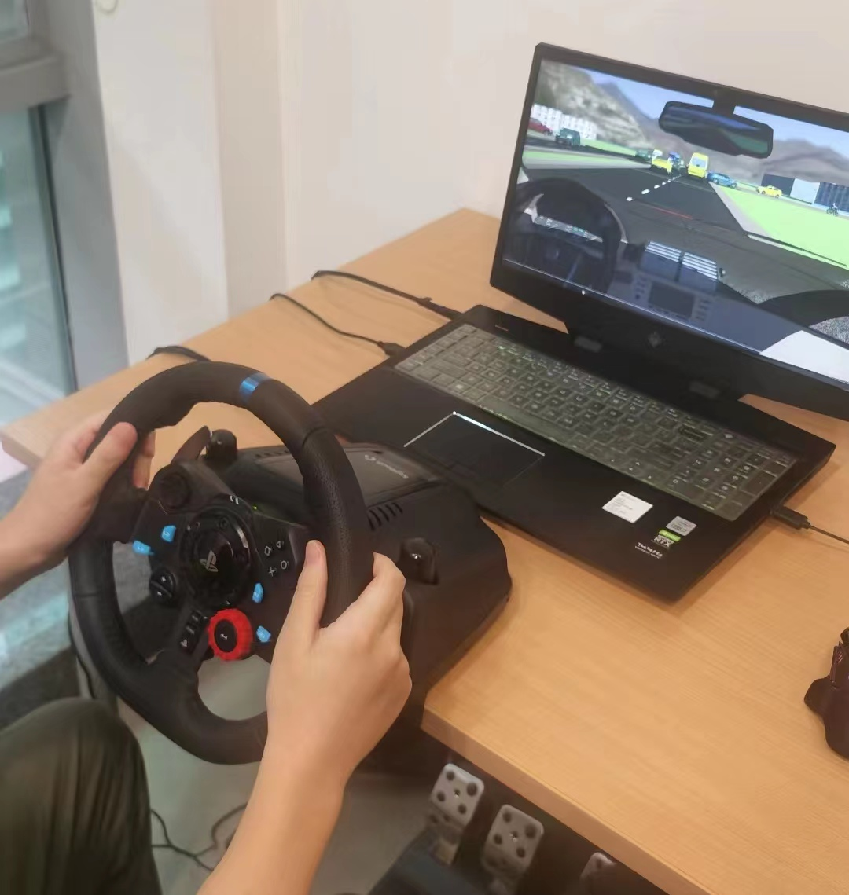
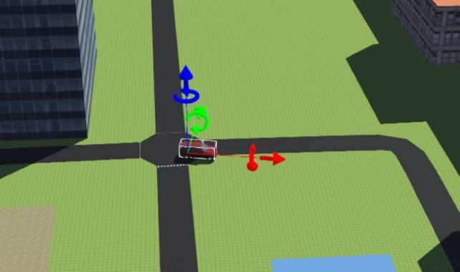
Digital-twin Prototype Design and Validation
for Connected and Automated Driving Simulation
Zijie Xu, Ziqiu Jiang, Zhekai Ma, Yiting Niu, Xinyi Xu, Yuchen Feng, Zheyu Zhou
Supervisor: Dr. Dongyao Jia Surf code:2022044
Abstract
A digital-twin is a real-time digital replica of a physical system, regarded as a promising methodology to bridge the virtual and real world and facilitate the design and optimization of different models.
This project aims to develop a digital twin prototype especially for connected driving simulation, which is expected to serve as an ideal testbed to validate and demonstrate the advanced connected and automated driving applications.
Overall, the proposed digital twin prototype system is composed of three components: local field sensor system, network deployment, and virtual simulation platform, as shown in the following diagram.
Local field sensor system
Local field sensors are deployed in the real world to obtain the real-time traffic
System Framework
information, which then will be uploaded to the IoT platform via MQTT protocol for message storage and exchange. This project focuses on vehicle position and speed, which are collected by GPS modules cooperate with Arduino.
Network deployment
Network deployment includes configuration of an IoT platform and a network middleware. Alibaba Cloud is selected as the IoT cloud platform, where a MQTT broker is integrated to coordinate data format and guarantee cloud communication between sensors system and the middleware.
The middleware is independently designed in this project to fetch and forward messages from one network terminal to the other one.
Virtual simulation platform
This component is based on the integrated Simulation platform for Conventional, Connected, and Automated Driving( SimCCAD), which tightly combines the core components of V2X (vehicle to everything) communication, traffic networks, and autonomous/conventional vehicle model. In this project, the open-source simulator Webots is applied to construct digital replica of real-world traffic environment.
Design and Implemetation
Early Information Collections
Network Middleware
The main purpose is to debug hardware devices and to include GPS information autonomously through the program
The middleware designed in this project is an independent executable file, which establishes duplex communication between the IoT platform and the simulator.
Hardware adjustment and preparation
It depends on the GPS module and 4G module of SIM7600
to collect or upload the data.
Structure of computer program : communicate with the arduino
The main purpose of this step is to collect GPS data and u
pload it to the AliCloud platform. As shown in Figure 1 this
is the entire code flowUse the sim7600 GPS module to
collect location data, and then use the MQTT to upload
data to Alibaba cloud. In order to complete the
autonomous control, the command is sent to the sim7600
through the arduino control board.
Flexible Network Connection
The middleware connects to Ali Cloud with MQTT and the simulator via local socket, which can create multiple connections with multiple simulator.
Multi-thread
Two tasks transmitting messages in the opposite directions in parallel is created to ensure duplex communication and the immediacy of messages.
Data Inspection
Data from Ali Cloud is checked with its timestamp, only real-time data in correct format is sent to simulator.
Visualization in Vehicle Driving Simulator
Digital Replica of Real-world Traffic Environment
The main purposes are to realize the access of multiple types of vehicles and the simulation of real-time data on Webots, the simulator.
Real-world environment are referred for simulation including roads and simple surrounding buildings in this section. Three types of traffic flow are designed: low/high density traffic flow and traffic flow in ordinary condition.
Establishment of vehicle model
A new type of vehicle is defined in python so that Webots functions can support it.
Real-time data binding and conversion
The controller is connected with the middleware to read real-time data, track and update vehicle position. Data is then processed by the conversion formula for next step.
Webots combination and mapping
Processed data from last step reflects the real vehicle motion and is mapped on Webots. Sumo is combined to display the position and simulate the traffic flow.
Location in Reality
This is the actual location chosen to generate the world in Webots. Two roads Wenjing Road and Songtao Street nearby the XJTLU were chosen for adding traffic flows and conducting real-world tests.
Virtual World
This is a screenshot from the simulation world, and traffic flows are created by a microscopic traffic simulator called SUMO.
Experiment and verification
Conclusion
The hardware has been wrapped in the box, which could be brought by the vehicles. The 4G antennas and the GPS antennas has been exposed, which help the information being collected conveniently.
The GPS device is equiped on the car and collect the real data. With the car moving, the data will be renewed.However, there existed a delay on the cloud service.
The current study uses the transmission of real data with a virtual platform to successfully build a digital twin model.
The data from the arduino,SIM7600 is transferred into the WEBOT software through the Ali cloud for data interaction.
In the future, this research could focus on reducing packet loss from data transmission and changing the GPS operating frequency to reduce the latency generated during data transmission
the vehicle in webots could collect data and be controlled by simulate driving device in first person view.users are allowed to operate the car in digital platform.
The GPS data has been printed in the screem. Sending the AT commands to the ports to complete the connect with aliyun cloud platform, which refer to the MQTT. The transmission rate is theoretically 10HZ
Project webpage:https://github.com/AAAAAkki/surf2022044
Reference
https://cyberbotics.com/doc/guide/supervisor-programming
The data from the arduino,SIM7600 is transferred into the WEBOT software through the Ali cloud for data interaction.
In the future, this research could focus on reducing packet loss from data transmission and changing the GPS operating frequency to reduce the latency generated during data transmission
Contact information:
Zijie Xu: zijie.xu20@student.xjtlu.edu.cn Zhekai Ma:MARK.JIANG.M@outlook.com
Ziqiu Jiang: Ziqiu.jiang20@student.xjtlu.edu.cn Yiting Niu:Yiting.Niu19@student.xjtlu.edu.cn
Xinyi Xu: Xinyi.Xu2002@student.xjtlu.edu.cn Yuchen Feng: Yuchen.Feng20@student.xjtlu.edu.cn
Zheyu Zhou: weszhou@outlook.com Dr. Dongyao Jia: Dongyao.Jia@xjtlu.edu.cn

